Slide 1
MALICIOUS ATTACK PREDICTOR
--Team members
J.Yashwanth raj
E.Manya
Rupali vadhera
B.Saloni

Slide 2
PROBLEM STATEMENT
To build a predictive model which can Identify a pattern in
these variables and suggest that a hack is going to happen
so somehow we can stop it before it actually happens

Slide 3
Malicious software
malicious software, is any program or file that is intentionally harmful to a computer, network or server.
Types of malware include computer viruses, worms, Trojan horses, ransomware and spyware.
You’ve noticed any of the following, you may have malware on your device:
A slow, crashing, or freezing computer
Programs opening and closing automatically or altering themselves
Lack of storage space
Increased pop-ups, toolbars, and other unwanted programs
Emails and messages being sent without you initiating them

Slide 4
Overview
Almost all the countries across the globe have adopted to means of digital payments , hacking has become a pretty common event where in the hacker can try to hack your details just with your phone number linked to your bank account
However, there is data with some anonymized variables like how many third party software’s installed and how many unknown links were opened by the user..etc.
based on which one can predict that the hack is going to happen .

Slide 5
Observations found in Dataset(EDA)
X_12 has missing values 182
almost (0.0076%)
We had replaced it with mean value of the X_12 column
Aslo we found duplicates values in 5 rows
Atlast We dropped those rows
We splitted DATE column into day month and year
And we dropped the DATE column
We dropped the incident id

Slide 6
Attributes of dataset
TRAINING DATASET
INCIDENT ID (unique identifier for an incident log)
DATE (date of incident occurrence)
(X_1) – (X_15) anonymized parameters
MALICIOUS_OFFENSE (target variable)
TESTING DATASET
INCIDENT ID (unique identifier for an incident log)
DATE (date of incident occurrence)
(X_1) – (X_15) anonymized parameters

Slide 7
PROCEDURE
The following are the steps we followed during the EDA and model building
Importing Datasets | Handling Null values | Univariate analysis | Bivariate analysis | Model building | The Best accurate model
Importing packages and data | Handlings duplicates values | Independent and dependent variables | Plotted some graphs | Following are models we have done | Logistic Regression Random forest decision tree
Exploring all numeric and categorical data | Dropping some of the columns | Almost found all the patterns how they vary with there values | Mostly compared using the heatmap | Linear regression Random forest decision tree Support vector machine Xg boost | Support vector machine Xg boost We got almost 95%

Slide 8
Interesting facts
Univariate analysis:
The shape of the Dataframe is 23856
In that almost the attacked is 22786
In the other hands not attacked is 1068
2. We have plotted the bar graph as well as the pie chart
3. It insights clear case of imbalance in data
4. Total: 23856
Positive: 22788 (95.52% of total)
Negative: 1068 (4.48% of total)

Slide 9
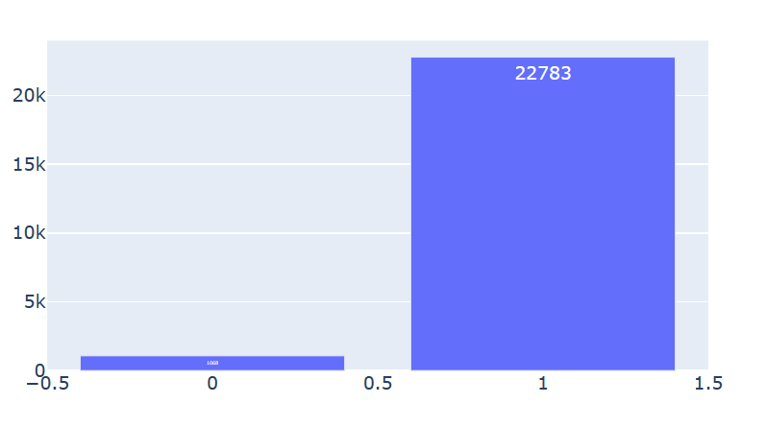
Bar graph of target variable
The count of
“1” is 22783 “0” is 1068

Slide 10
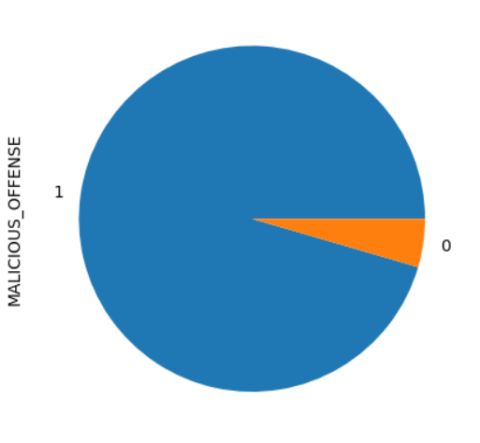
Pie chart of target variable
Total: 23856
Positive: 22788 (95.52% of total)
Negative: 1068 (4.48% of total)

Slide 11
Interesting facts bivariate analysis
We observed two independent variables namely (X_2),(X_3)
changes almost at the same rate(1)
2. Also we observed that (X_10),(x_12)
almost vary by 0.88%
3. We plotted scatterplot and we got a linear points on the graph we made

Slide 12
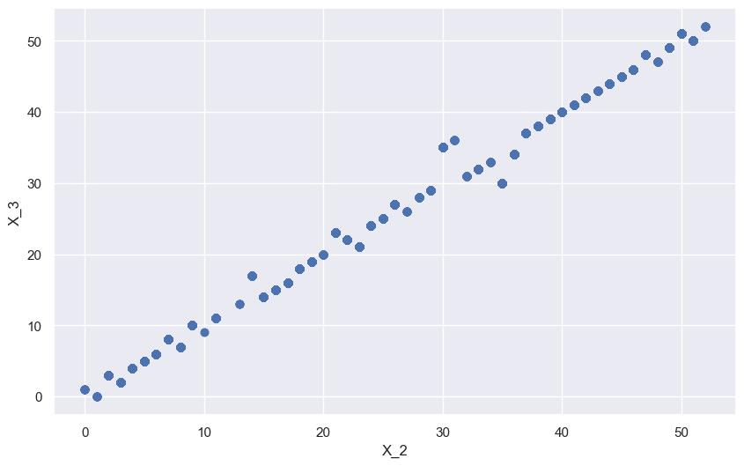
Scatter plot (X_2 vs X_3)
We got linear points

Slide 13
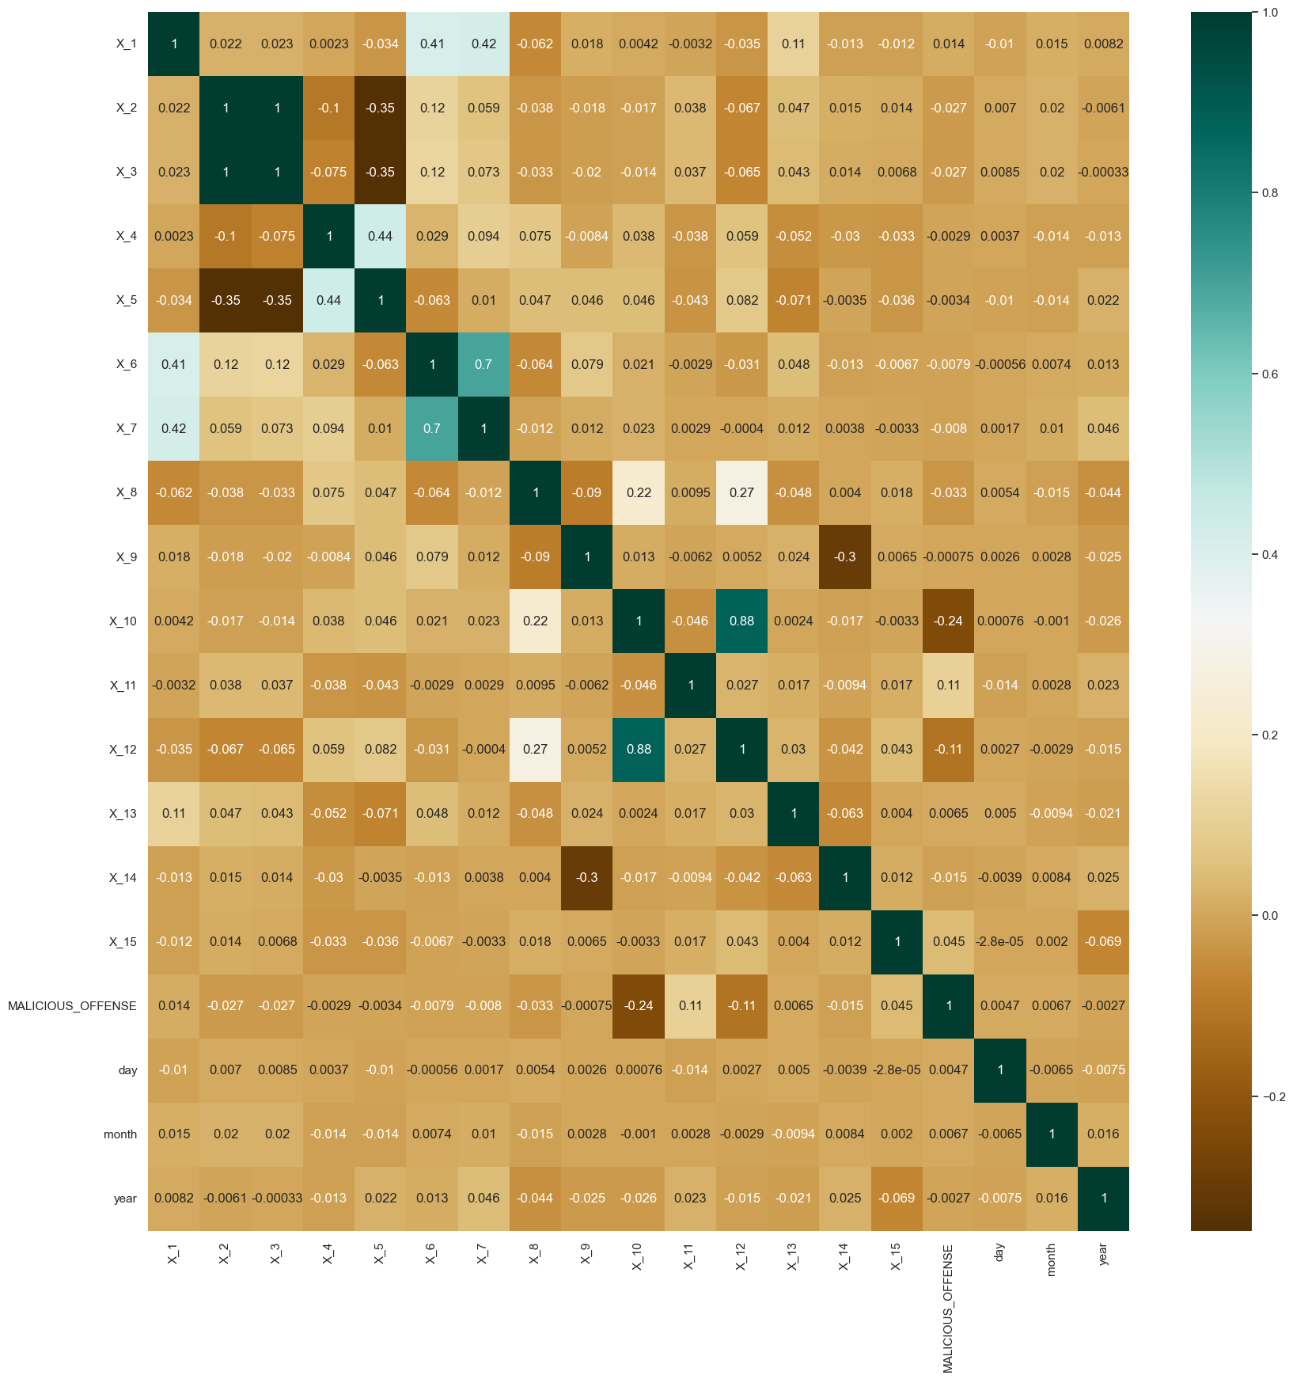
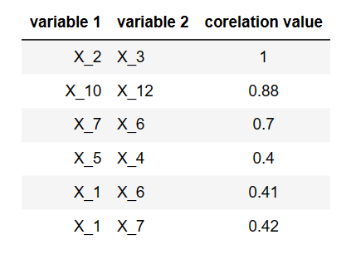
Heat map

Slide 14
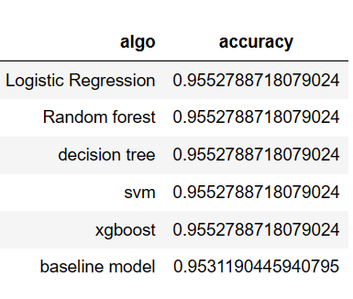
Model building
After EDA , we applied 6 classification algorithms and got below accuracies

Slide 15
Conclusion
General conclusions that can be drawn from our EDA and modelbuilding :
Relationship between variables
Importance of data quality
Model performance evaluation
Assumptions and limitations
Decision support

Slide 16
Resources
List the resources you used for your research:
Kaggle and github
Chatgpt
Data preprocessing libraries

Slide 17
Questions & answers
Invite questions from the audience.

